Slide 1


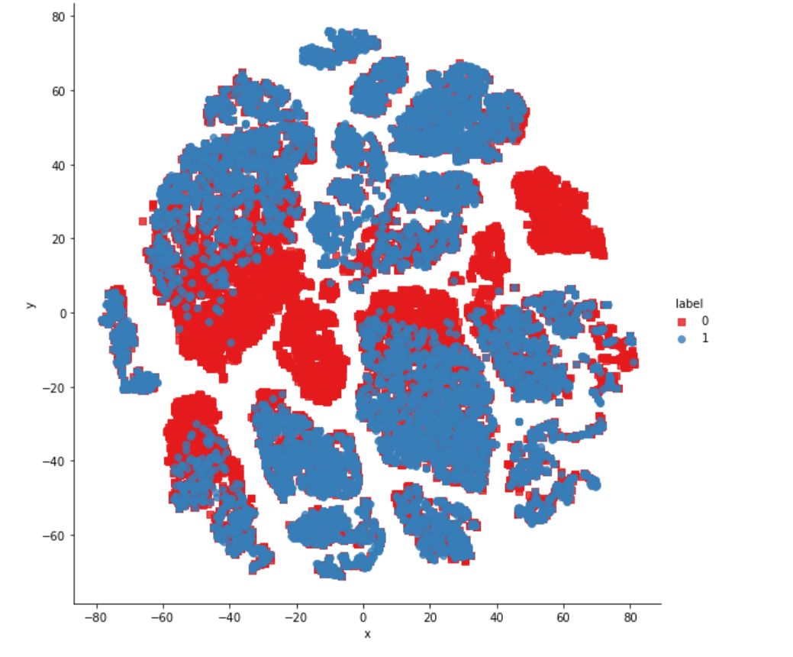
Department of Information Science and Engineering
Department of Information Science and Engineering
DUPLICATE QUESTION PAIRS DETECTION WITH
DATA ANALYSIS
Student Names and USN
Nishanth D Kini 1NT19IS100
Nanjunda Swamy Nadiga BN 1NT19IS091
N Vishwas 1NT19IS087
Dharmik MP
Guide Name:
Mr Rohith HP

Slide 2
DUPLICATE QUESTION PAIRS DETECTION
1. The main aim of this project is to detect or analyze whether the given two questions in each row of the dataset
is same or not with reference to the meaning of the sentences and thus give a conclusion whether the pair of
sentences is duplicate or not .
2. It is represented as 0→not-duplicate and 1→duplicate.
3. The ground truth is the set of labels that have been supplied by human experts. The ground truth labels are
inherently subjective, as the true meaning of sentences can never be known with certainty. Human labeling is
also a 'noisy' process, and reasonable people will disagree. As a result, the ground truth labels on this dataset
should be taken to be 'informed' but not 100% accurate, and may include incorrect labeling. We believe the labels,
on the whole, to represent a reasonable consensus, but this may often not be true on a case by case basis for
individual items in the dataset.
4. Consider the following pair of questions:
Is talent nurture or nature?
Are people talented by birth or can it be developed?
These are duplicates; they are worded differently, but they have the same intent. This project focuses on solving
the problem of duplicate question identification.

Slide 3
Data fields
id - the id of a training set question pair
qid1, qid2 - unique ids of each question (only available in train.csv)
question1, question2 - the full text of each question
is_duplicate - the target variable, set to 1 if question1 and question2 have essentially the same meaning, and 0 otherwise.

Slide 4
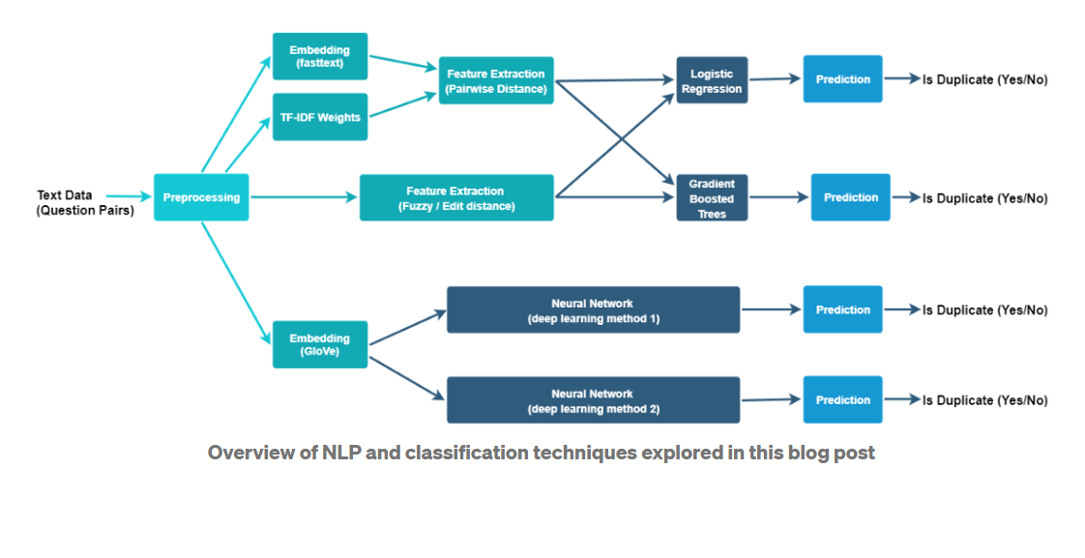
Approach
Suppose we have a fairly large data set of question pairs that has been labeled (by humans) as “duplicate” or “not duplicate.” We could then use natural language processing (NLP) techniques to extract the difference in meaning or intent of each question-pair, use machine learning (ML) to learn from the human-labeled data, and predict whether a new pair of questions is duplicate or not.

Slide 5
This project is actually divided into 2 phases:
Detecting the duplicate questions by using the BOW(Bag of words) model and then using
Random Forest and XGB to get the accuracy All this is done without pre-processing
techniques or feature engineering processes.
Using pre-processing techniques and then using advanced features like Tokenization,
Length-based features and Fuzzy features.

Slide 6
Phase-1
First we import the required dataset and then since this is human entered labels as duplicate
Or not-duplicate we find the total number of duplicate and non-duplicate rows. We also do
Data analysis for the same by plotting a couple of histograms and analysing its behaviour.
Then we check how many questions are repeated in the entire dataset even though we are
Not doing the data-preprocessing techniques and all.
Next we import CountVectorizer and consider the BAG-OF-WORDS model and whatever data
The BOW model gives through that we train the model and test it . For this we use Random
Forest and XGB to calculate the accuracy of the correct predictions as duplicate or non-duplicate

Slide 7
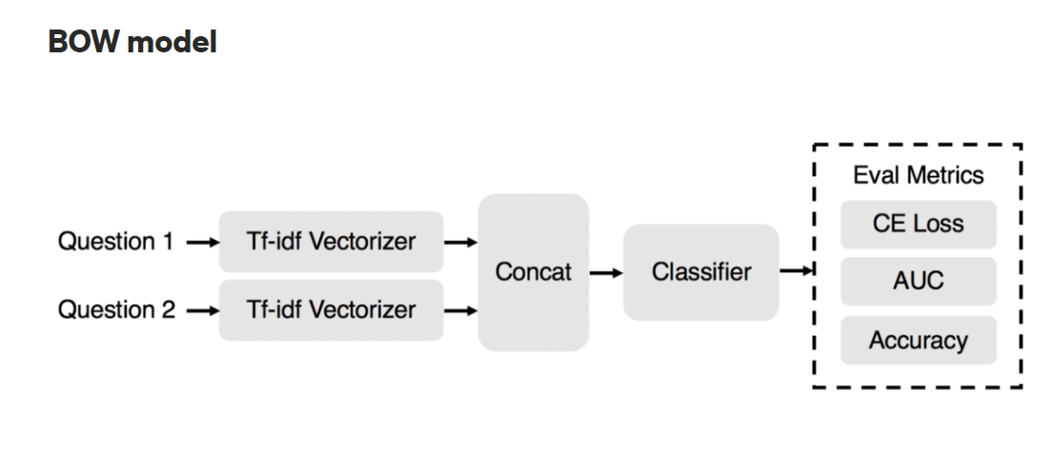

Slide 8
BAG OF WORDS
Sentence-1 ----- He is a good boy. Stop keywords Sentence-1 ------ good boy
Sentence-2 ------ She is a good girl. ➔➔➔ Sentence-2 ------ good girl
Sentence-3 ------- Boy and girl are good. Lower the case Sentence-3 ------ Boy girl good
 | Good | Boy | Girl | Output
Sent-1 | 1 | 1 | 0
Sent-2 | 1 | 0 | 1
Sent-3 | 1 | 1 | 1
Words Frequency
Boy 2
Girl 2
Good 3
➔ (Vectors)

Slide 9
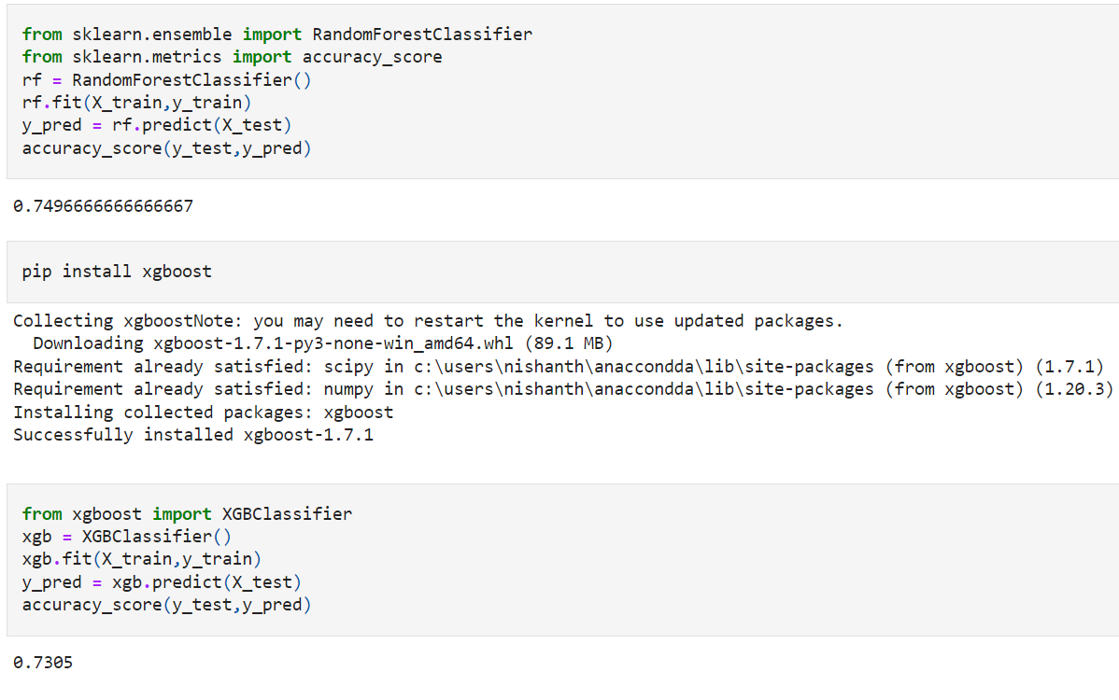
ACCURACY WITHOUT APPLYING PRE-PROCESSING OR ADVANCED FEATURES

Slide 10
REFERENCES
https://towardsdatascience.com/duplicate-question-detection-using-word2vec-xgboost-and-autoencoders-f9353d58ba34
https://medium.springboard.com/identifying-duplicate-questions-a-machine-learning-case-study-37117723844
https://machinelearningmastery.com/gentle-introduction-bag-words-model/

